Slide 1



THINKHALL ACADEMY
INTERVIEW SKILLS
Ways to get appointed for a Job

Slide 2
Main Topics
Points to talk about
Prepare
Discipline
Communication
Personality
Post interview

Slide 3
Preparation for a Job Interview
The preparation will need a whole-hearted effort from readiness of your resume to learning about the company.
Here is the step by step preparation plan checklist
Create a powerful resume
Learn about the company on internet or talk to an ex employee
If possible learn about the interviewer you are going to meet.
Get your Q&A prepared.
Practice
Prepare
Thinkhall Academy

Slide 4
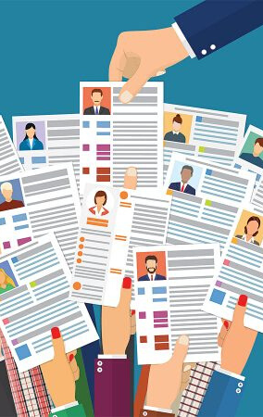
Resume
Should not just look great and precise. It should also talk oodles about your academics, achievements and experience.
Creating powerful resume is the first step to getting noticed by your employer. Many templates are floating in the market which is difficult to choose.
Thinkhall Academy has eased that pain. Go ahead and fill your details online, you can download your details into a great looking resume with different features.

Slide 5
Prepare
COMPANY
Always learn about the company either through internet or through someone who has a good knowledge of the company. For example, an ex-employee
LEARN ABOUT THE PEOPLE
It is important to learn about the people whom you will be meeting for the interveiw as well. Try to know the person better professionally
QUESTIONS AND ANSWERS
Prepare probable Q&A and rehearse them to ensure perfection.

Slide 6
WE NEED TO SHOW ABSOLUTE DISCIPLINE TO ATTEND AN INTERVIEW
  Be Punctual
  Show Professionalism at all points
  Discipline should be also in the way you dress - sharp formals are better for interview always.
  Show discipline in Calling on time before and after the interview as well
Discipline

Slide 7
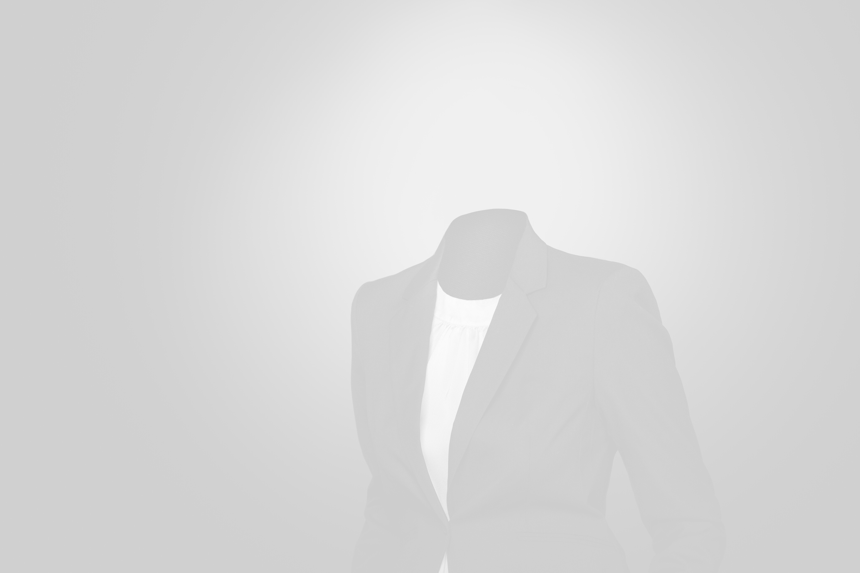
THINK ABOUT IT:
Job interview is NOT the test of your knowledge, but the ability to use it at the right time.

Slide 8




Communication
WRITING WELL
SPEAKING
Communication is also in the form of emails. Your emails should be timely, polite and to the point. No one is looking for long conversations through emails
When you communicate effectively, you sentences are precise, making sure the pauses are perfect, helping the other person to understand well. It is at the right, pitch and tone. You are using right grammar as well.
ON THE PHONE
ON VIDEO CALLS
Try to be professional, disciplined, precise and polite over a phone call. Saying the same thing again and again will only digress you from the topic and listener will lose interest as well
Interview over video calls are common. Ensure no noise in your background. The background is not disturbing or too casual. camera and mic are on only as and when required

Slide 9
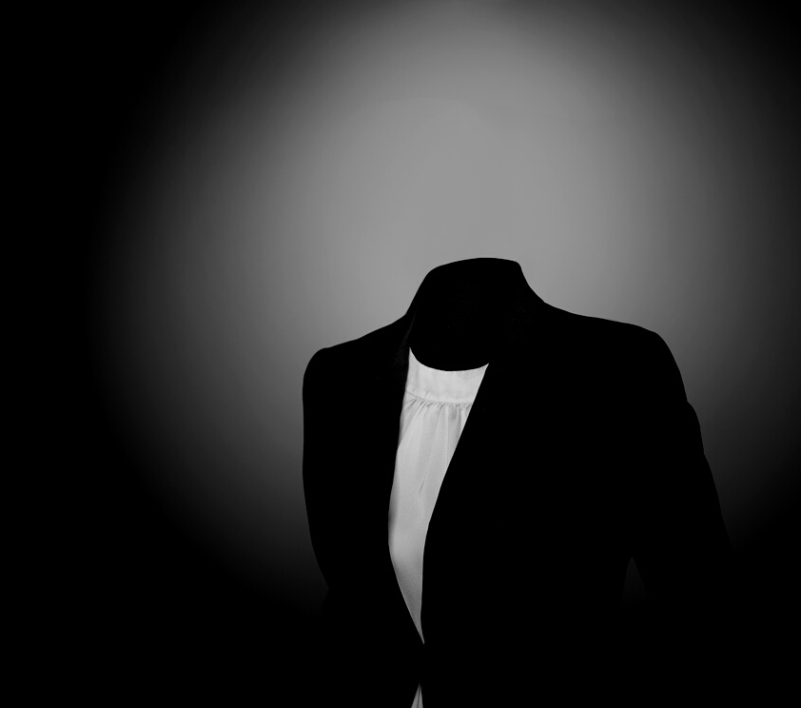
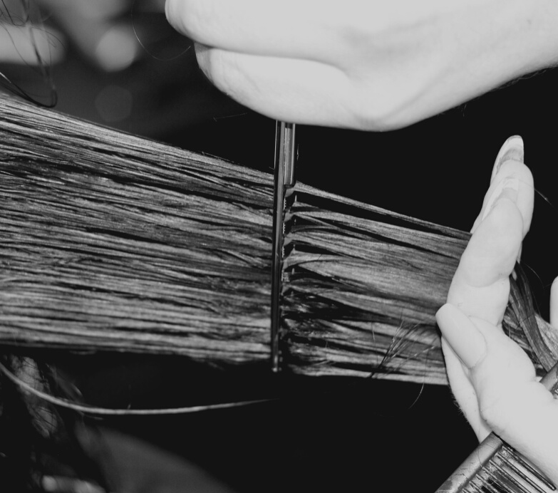
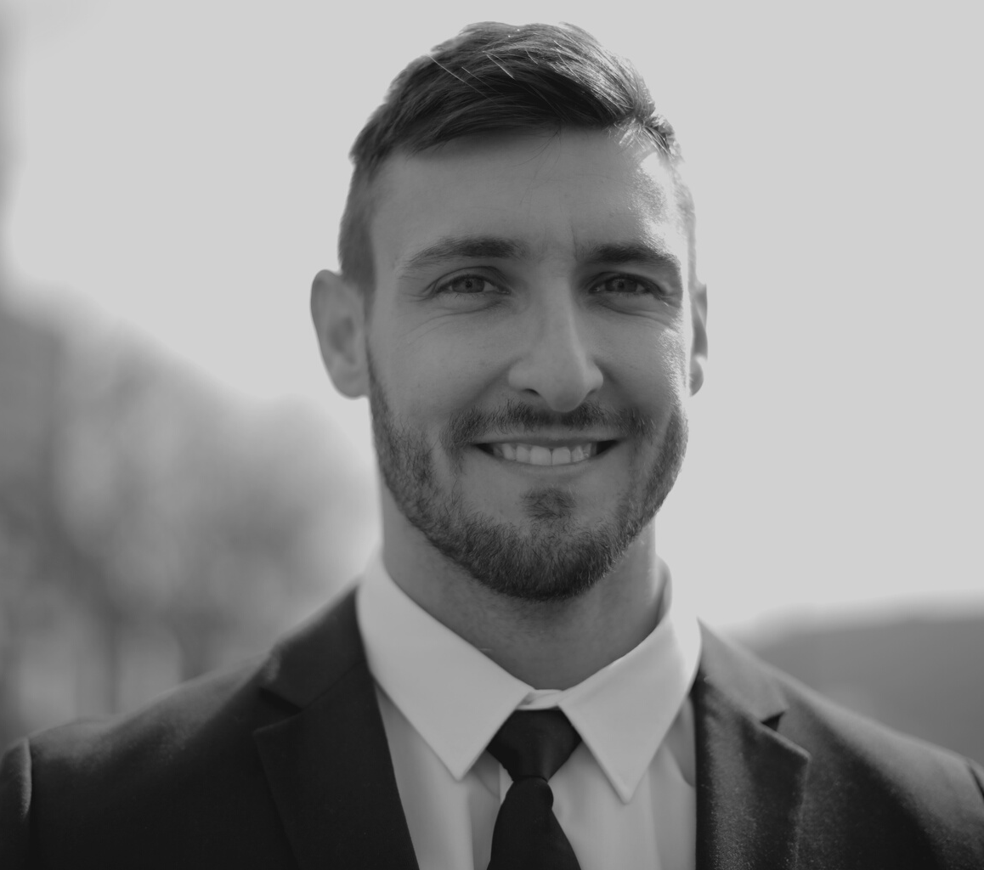
WHAT YOU WEAR
Personality is the reflection of what you wear. For interview dress in sharp formals, Pay attention to accessories and shoes as well
GROOMING
Personality
Reaching for an interview, without shaving beard or with chipped nailpolish is also not right. Get groomed well before you reach the interview
ATTITUDE
Your personality is also a reflection of your attitude. Be willing to help, eager to learn and polite and humble. At the same time show confidence and leadership qualities that will help in your selection

Slide 10

After Interview
IMPORTANT FOLLOW UPS
CALL UP TO ASK RESULTS
Ask for feedback after the interview is over from the HR to ensure you know the chances of your selection.
LEARNING
Learn to work on your feedback that may provide a solid base for you to start for your next interview

